Slide 1
Market Forces of Demand and Supply
Dr. Dowlah
Fall 2016

Slide 2
Market
Market is anywhere economic transaction takes place.
It’s a place or service that enables buyers and sellers to exchange goods and services
It refers to the interaction of buyers and sellers to make an economic transaction

Slide 3
Demand vs. Quantity Demanded
Demand is the amount of a product/service that people are willing and able to purchase at each possible price during a given period of time.
The quantity demanded (Qd) is the amount of a product/service that people are willing and able to purchase at a specific price.

Slide 4
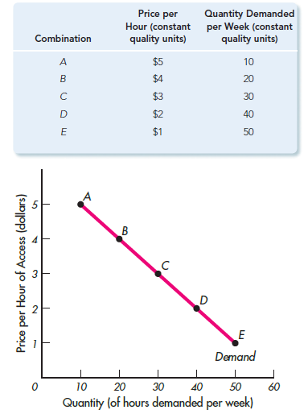
Demand Schedule and Demand Curve
Demand Curve: A graph of the demand schedule with price on the vertical axis and quantity demanded on the horizontal axis.

Slide 5
Law of Demand
As price of a good rises, consumers buy less, and as price of a good falls, consumers buy more.
That means, ceteris paribus, Price (P) and Quantity Demanded (Qd) move in opposite direction.

Slide 6
Difference Between Change in Demand and Change in Quantity Demanded
Change in Demand refers to a shift in the entire demand curve in response to a change in any of the determinants of demand
Change in Quantity Demanded (Qd) –refers to a movement along the same demand curve in response to a change in price.

Slide 7
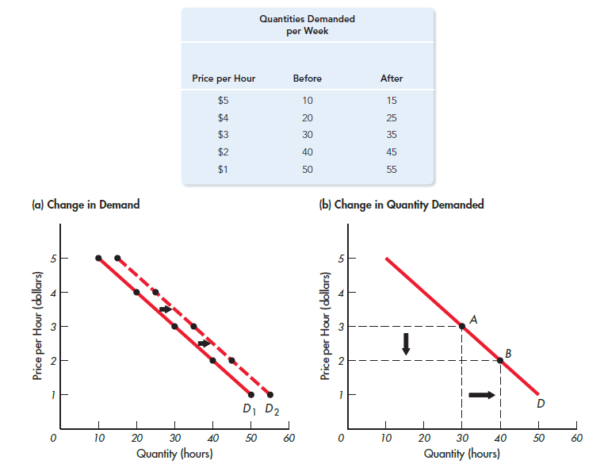
Change in Demand vs. Change in the Quantity Demanded

Slide 8
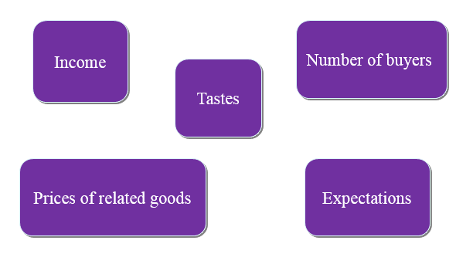
Determinants of Demand: Factors that may cause a shift in demand curve

Slide 9
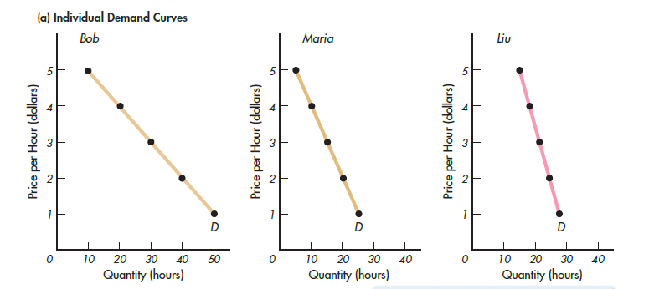
Market Demand: Aggregation of quantity demanded at various prices

Slide 10
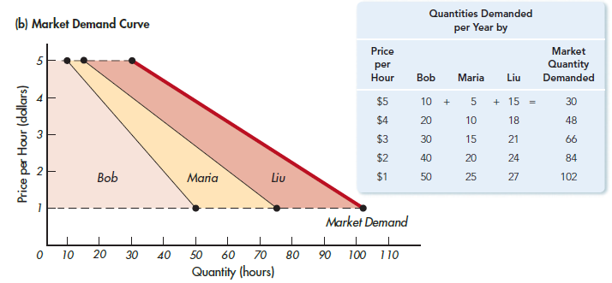
Market Demand-Horizontal summation of individual demand curves

Slide 11
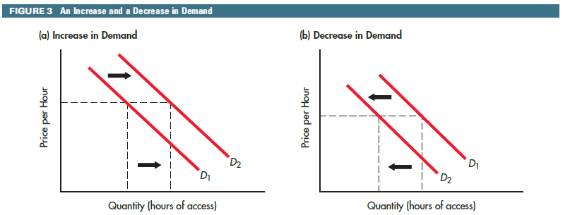
A changes in Demand Curve causes increase or decrease in Demand

Slide 12
Supply vs. Quantity Supplied
Supply (S)is the amount of a good or service that producers are willing and able to offer for sale at each possible price during a period of time, all else constant.
The quantity supplied (Qs)is the amount sellers are willing and able to offer for sale during a period of time at a specific price, all else constant.

Slide 13
Law of Supply
Law of Supply
As the price of a product rises, producers will be willing to supply more, and vice versa.
The height of the supply curve at any quantity shows the minimum price necessary to induce producers to supply that next unit to market.

Slide 14
Supply Schedule and Supply Curve
Supply Schedule: It’s a table or list of the prices and corresponding quantities supplied of a particular good or service. The price-quantity supply relationship presented in tabular form.
Supply Curve: A graph of the supply schedule with price on the vertical axis and quantity supplied on the horizontal axis. It shows willingness and ability of suppliers to supply goods/services at various prices.

Slide 15
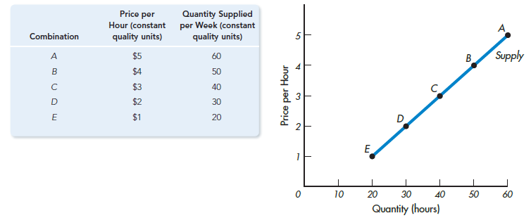
Supply Schedule and Supply Curve

Slide 16
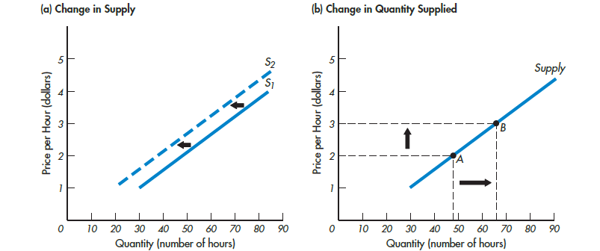
Change in Supply vs. Change in the Quantity Supplied
Change in Supply refers to a shift in entire supply curve.
Change in Quantity Supplied (Qs) –shows a movement along the same supply curve in response to a change in price.

Slide 17
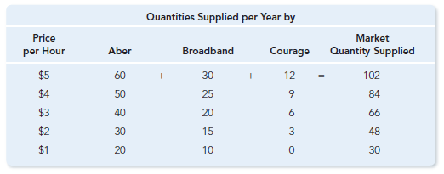
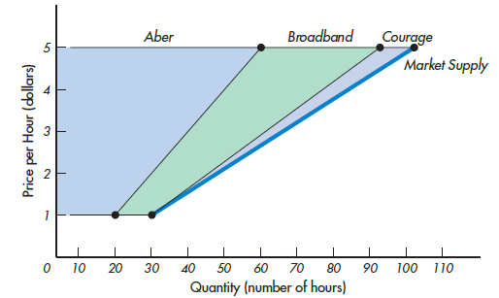
Market Supply: Horizontal summation of individual supply curves

Slide 18
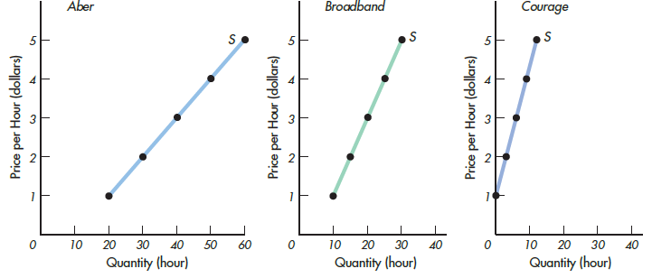
Market Supply: Aggregation of Individual Supply curves

Slide 19
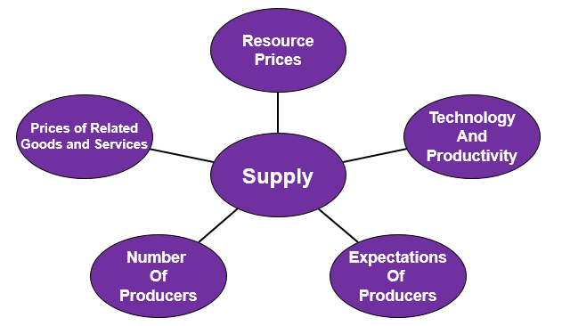
Determinants of Supply—the Factors that Shift Supply

Slide 20
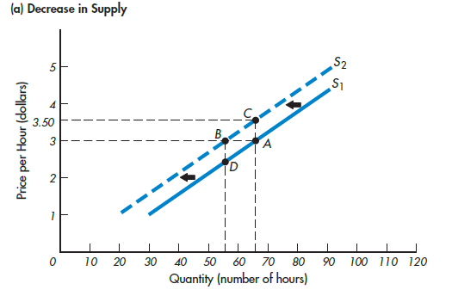
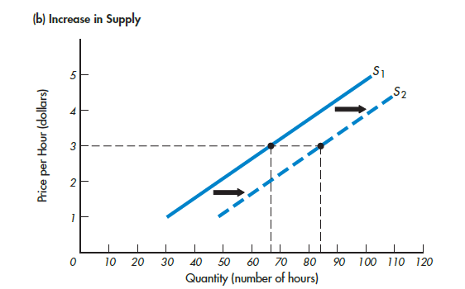
A change in supply curve causes increase or decrease in supply

Slide 21
Market Equilibrium
Market Equilibrium is the price and quantity at which the quantity supplied and the quantity demanded are equal.
A market is said to be in disequilibrium at all points at which the quantities demanded and supplied are not equal.
A surplus occurs whenever Qs>Qd.
A shortage occurs whenever Qd>Qs.
Surpluses and shortages can be resolved with price changes.

Slide 22
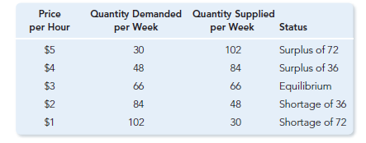
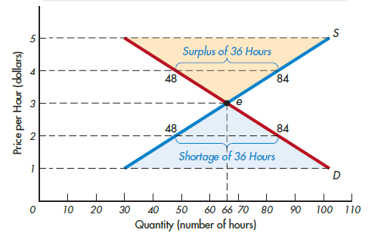
Market Equilibrium

Slide 23
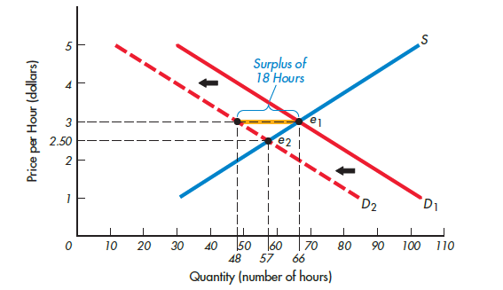
The Effects of a Shift of the Demand Curve when supply remains constant

Slide 24
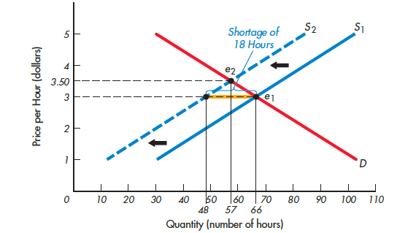
The Effects of a Shift of the Supply Curve when demand curve remains constant

Slide 25
Market Equilibrium and Invisible Hand of Market
The concept of invisible hand of market, first explained by Adam Smith, states that the forces of demand and supply automatically restore market equilibrium in the absence of any intervention.
If price is above the equilibrium point, sellers reduce price and cut down output. As prices go down, buyers demand more, and that eventually helps market to return to equilibrium.
If price is below equilibrium, sellers raise price and increase output. As price goes up, buyers demand less. Eventually, market equilibrium is restored.

Slide 26
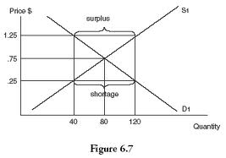
Invisible Hand of Market
Surplus is a situation in which quantity supplied is greater than quantity demanded.
Shortage is a situation in which quantity demanded is greater than quantity supplied.
This graph shows surplus of 80 when price is $1.25, and shortage of 80 when price is $.25

Slide 27
Government Intervention in Market
Governments, however, often address the problems of shortages and surpluses through something called Price Controls.
Two of the most common forms of government control of prices are known as Price Ceiling and Price Floor.

Slide 28
Price Floors
A price floor is a legal minimum on the price of a good or service.
If the price floor is above the equilibrium price, the quantity supplied exceeds the quantity demanded.
Because of the resulting surplus, buyers’ demands for the good or service must in some way be rationed among sellers.

Slide 29
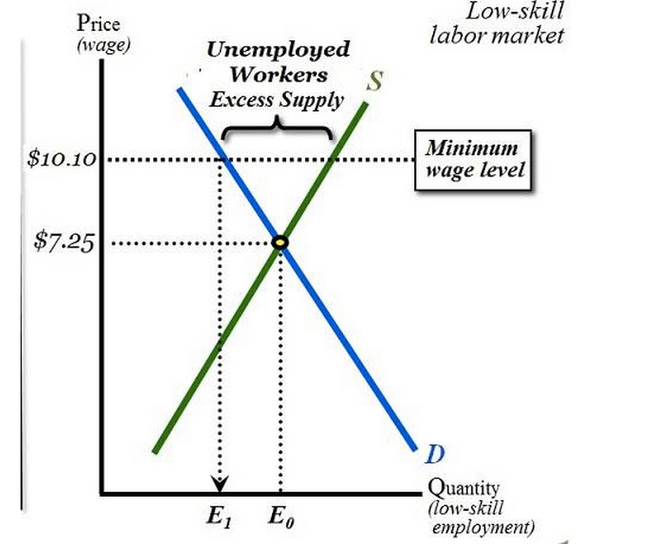
Effects of Minimum Wage Legislation
If the minimum wage is fixed above the equilibrium wage in the labor market, a surplus of labor will develop.
As the minimum wage is a binding constraint, employers will be able to discriminate workers.

Slide 30
Price Ceiling
A price ceiling is a legal maximum on the price of a good or service.
If the price ceiling is below the equilibrium price, the quantity demanded exceeds the quantity supplied.
Because of the resulting shortage, sellers must in some way ration the good or service among buyers.

Slide 31
Effects of Rent Control laws
Before Rent Control Law—Rent is $1,000, and apartment demanded was 2.0 millions. With rent control law, rent fell to $800, but a shortage has been created for 400,00 apartments.

Slide 32
Evaluations of Price Control
Most economists believe that markets are usually a good way to organize economic activity, and most of them oppose the use of price ceilings and floors.
If prices are set by laws, they obscure the signals that efficiently allocate scarce resources in a market economy.
Studies suggest that Price ceilings and price floors often hurt the people they are intended to help.

